Slide 1
NFL DRAFT PREDICTION
NOV
05
Group 9

Slide 2
LET’S CELEBRATE!
Charles Quinn
Brandon Loredo
Alice Liu
Bryan Miller

Slide 3
Objectives
Predict NFL draft round based on NFL Combine stats
Evaluate models based on accuracy
Provide actionable insights for players and scouts
Enable data-driven decision-making in player selection

Slide 4
PROJECT TIMELINE
10 / 10 / 2023
Data Exploration
& Database
10 / 12 / 2023
Drafted?
10 / 13 / 2023
Basic Models
10 / 16 / 2023
Neural Net
Charles Quinn
Brandon Loredo
Alice Liu
Bryan Miller

Slide 5
DATASETS
Combine Stats
NFL Draft
Contains combine statistics (40-yd, bench, vertical, etc.) for everyone who participated in the NFL Combine from 2000 - 2022.
Contains NFL Draft round, pick & game statistics for all players from 1985 - 2015.
Combine Source:
https://www.kaggle.com/datasets/mitchellweg1/nfl-combine-results-dataset-2000-2022
Draft Source:
https://www.kaggle.com/datasets/ulrikthygepedersen/nfl-draft-1985-2015/data

Slide 6
01
DATABASE &
EXPLORATION
Charles Quinn

Slide 7
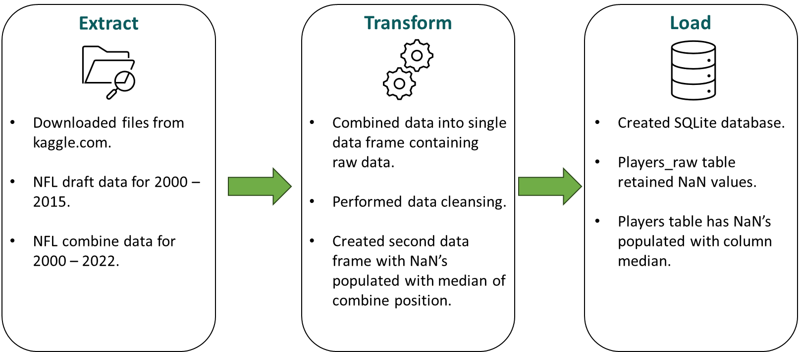
ETL Process

Slide 8
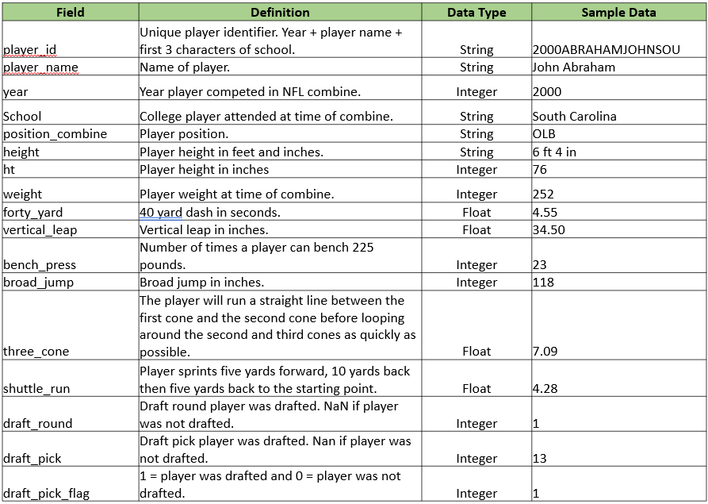
Data Dictionary

Slide 9
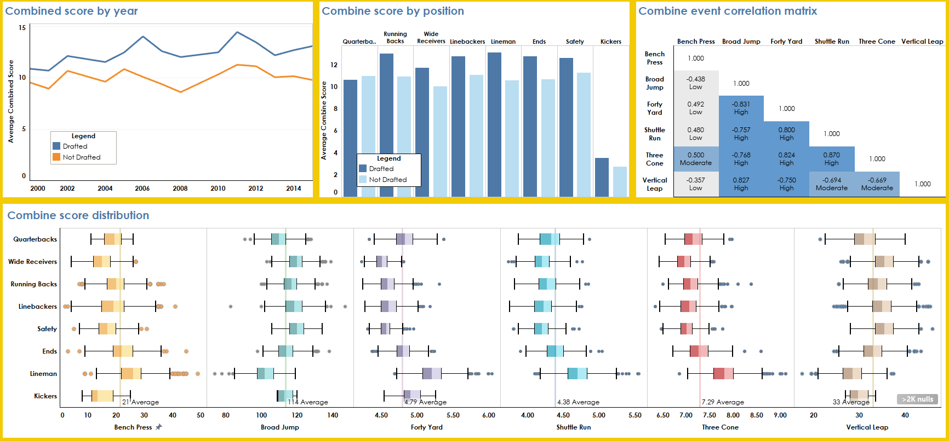
Data Exploration

Slide 10
02
Will You Get Drafted?
Brandon Loredo

Slide 11
Features
Target
Cleaning Prepping Processing Testing
Missing Values
Notes
Year, Height, Weight, Forty Yard, Vertical Leap, Bench Press, Broad Jump, Three Cone, Shuttle Run
Drafted or not
Test by using both mean and median to fill NaN
Height conversion IF_DRAFTED column

Slide 12
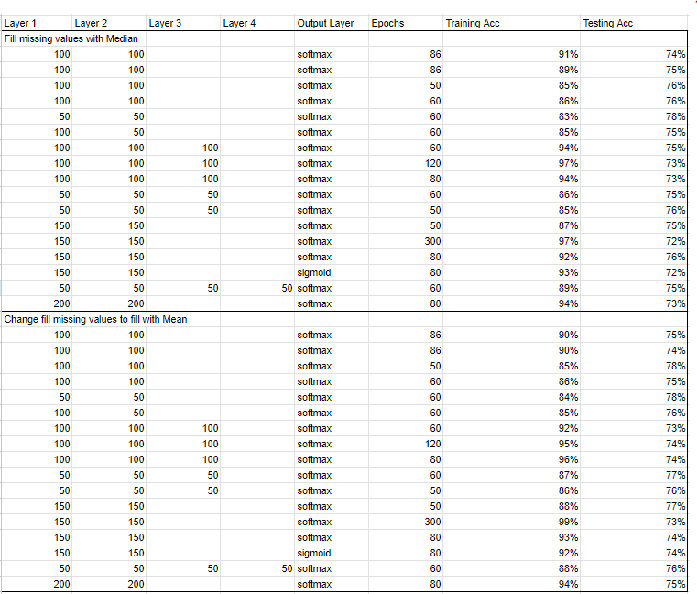
Training/Testing Accuracy

Slide 13
03
BASIC
MODELS
Alice Liu

Slide 14
DATA
CLEANING
01
DROP ROWS
02
HEATMAP
03
ENCODING
Dropped NFL players that did not attend the Combine
Created a heatmap to visualize highly correlated features
Turned position and team from labels into numbers.
Labelled undrafted players.

Slide 15
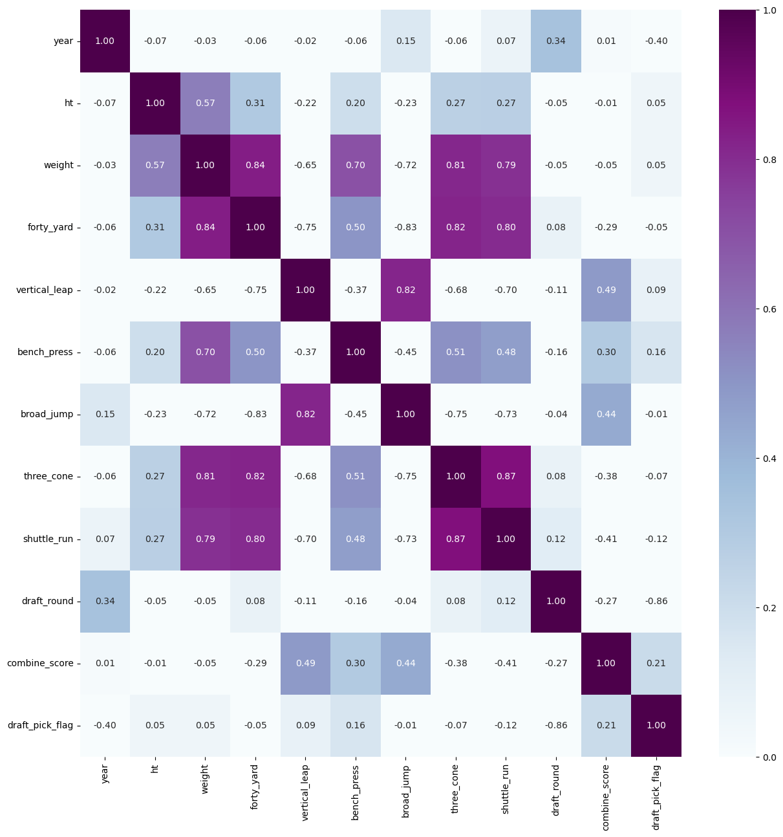
HEATMAP
Removed Columns:
Weight
Three cone
Shuttle run
Draft pick flag

Slide 16
Decision Tree
Naive Bayes
SOME
DIFFERENT
MODELS
KNN
Random Forest
Best for simple/small datasets
Best for independent features
Easy to use
Decision Tree, but better

Slide 17
Accuracy Scores
Uses ML to Input Missing Data
Standard Scalar
Only Contains Drafted Players
 | Mice Imputation | MI + Scaled | Drop NANS
DT | 0.62 | 0.62 | 0.95
NB | 0.61 | 0.62 | 0.94
KNN | 0.62 | 0.61 | 0.92
RF | 0.63 | 0.63 | 0.97

Slide 18
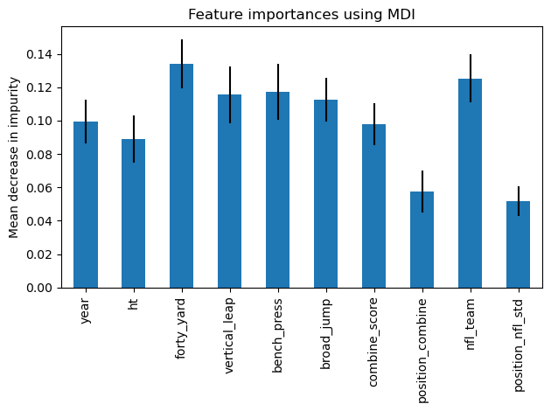
Feature Importance

Slide 19
04
NEURAL NET
Bryan Miller

Slide 20
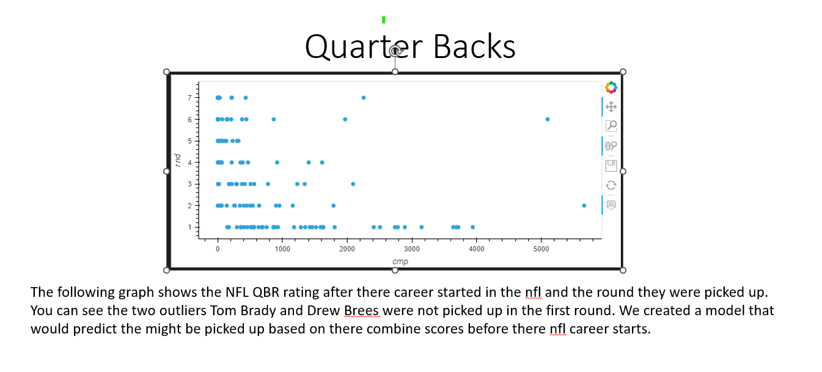

Slide 21
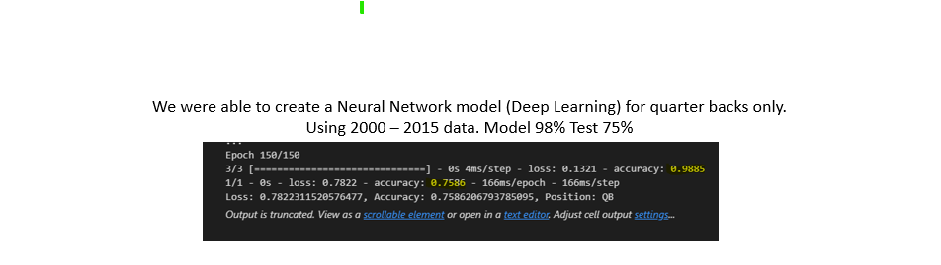
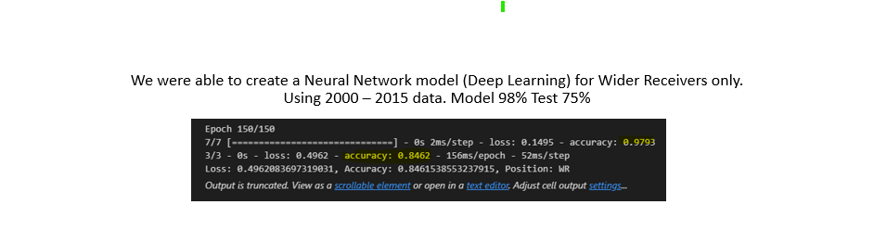
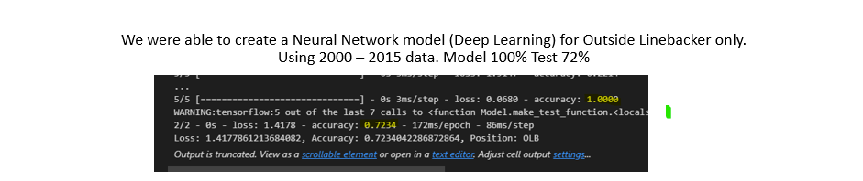

Slide 22
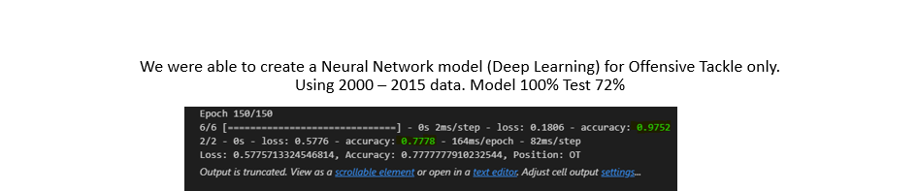
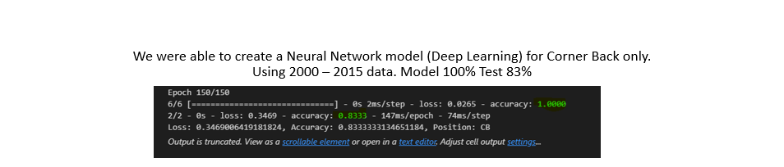
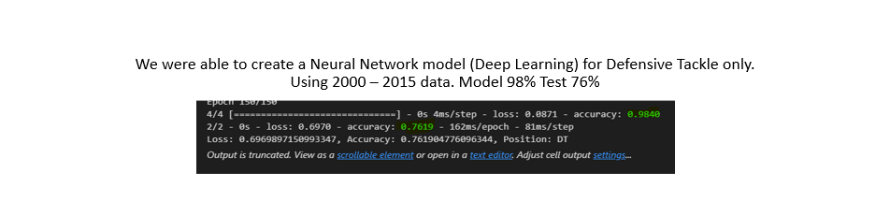

Slide 23
EPochs - 3 layer - Accuracy
80 70-50-40 .689
85 70-50-40 .4827
75 75-50-40 .95
Models used

Slide 24
THANKS!
Does anyone have any questions?
Please keep this slide for attribution

